Slide 1

Text Planning
for the FPB

Slide 2
www.wetenschappelijkschrijven.nl

Slide 3
Agenda
Opening
Your writing process
- Part 1: from Text to Text plan
11.00 Break
- Part 2: from Text plan to Text
- Wrap-up: Evaluation and how to continue?

Slide 4
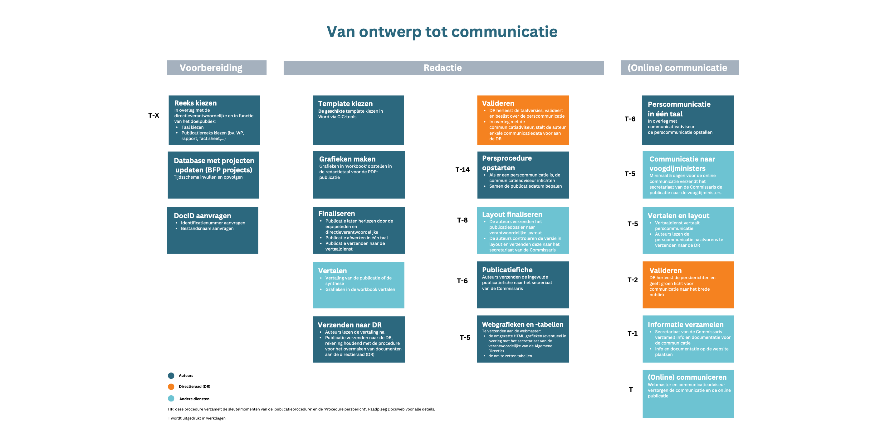


Slide 5
About text planning
Today is not about MAKING text plans, but WORKING with text plans
A text plan is a working document, not a product
A text plan will evolve on the way, and grow into a well-built text
The aim is to support the writing process + a transparent structure

Slide 6
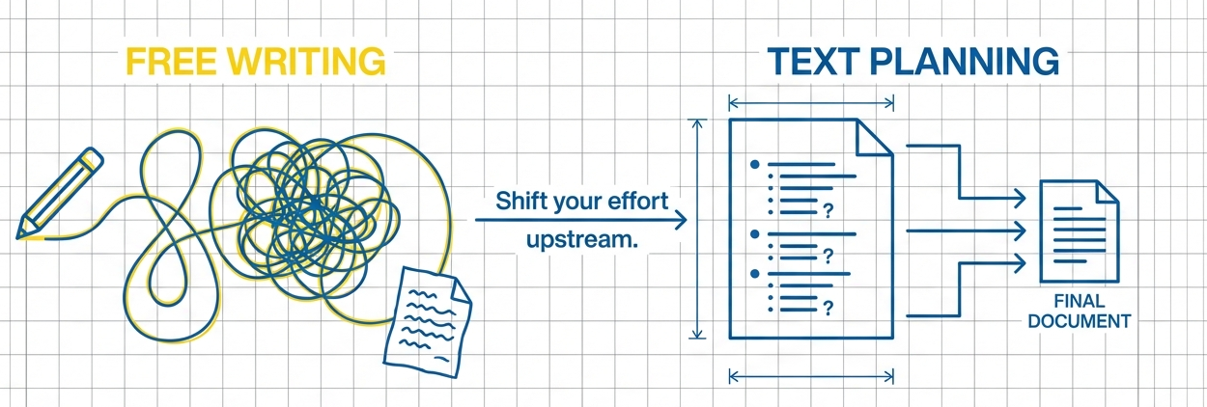

Slide 7
Part 1
From text to text plan

Slide 8

The reader’s perspective

Slide 9
Does economic inequality affect well-being and mental health?
A counterintuitive answer from a global study
What are your questions as a reader?

Slide 10
Does economic inequality affect well-being and mental health?
A counterintuitive answer from a global study
What is the intuitive answer? And what the counterintuitive one?
What kind of global study is this (design? how big)?
How are well-being and mental health measured in this study?
How do the authors separate the effect of inequality from the effect of being poor?
.......
......

Slide 11
Text = answers to questions
Answers to reader’s questions
+
Answers you want your readers to remember

Slide 12
Find the skeleton
Read the article – and identify the questions
Note them in the second column

Slide 13
the paragraph – le paragraphe – de alinea
A paragraph is a group of related sentences that develop one main idea within a larger text.
Un paragraphe est un ensemble de phrases liées qui développent une idée principale dans un texte.
Een alinea is een stukje tekst waarin zinnen samen één hoofdgedachte uitwerken.

Slide 14
Section | Questions
Executive Summary
1. Introduction
2. Method
3. Results
4. Conclusion / Discussion

Slide 15
Section | Question
Executive Summary | Overall questions: gap, methods, findings, implications?
1. Introduction | What is the topic? What does the research add? Why is it relevant? What is known from the literature? What is the knowledge gap? What are the research questions?
2. Method | What data (and methods) do we use?
3. Results | What are the findings? (Answers to the research questions)
4. Conclusion / Discussion | What are the main findings and what do they mean? How can we interpret or explain them? Why are the findings surprising/not surprising? What are the limitations of this research? What can we conclude from the findings? How do we look to the future?

Slide 16
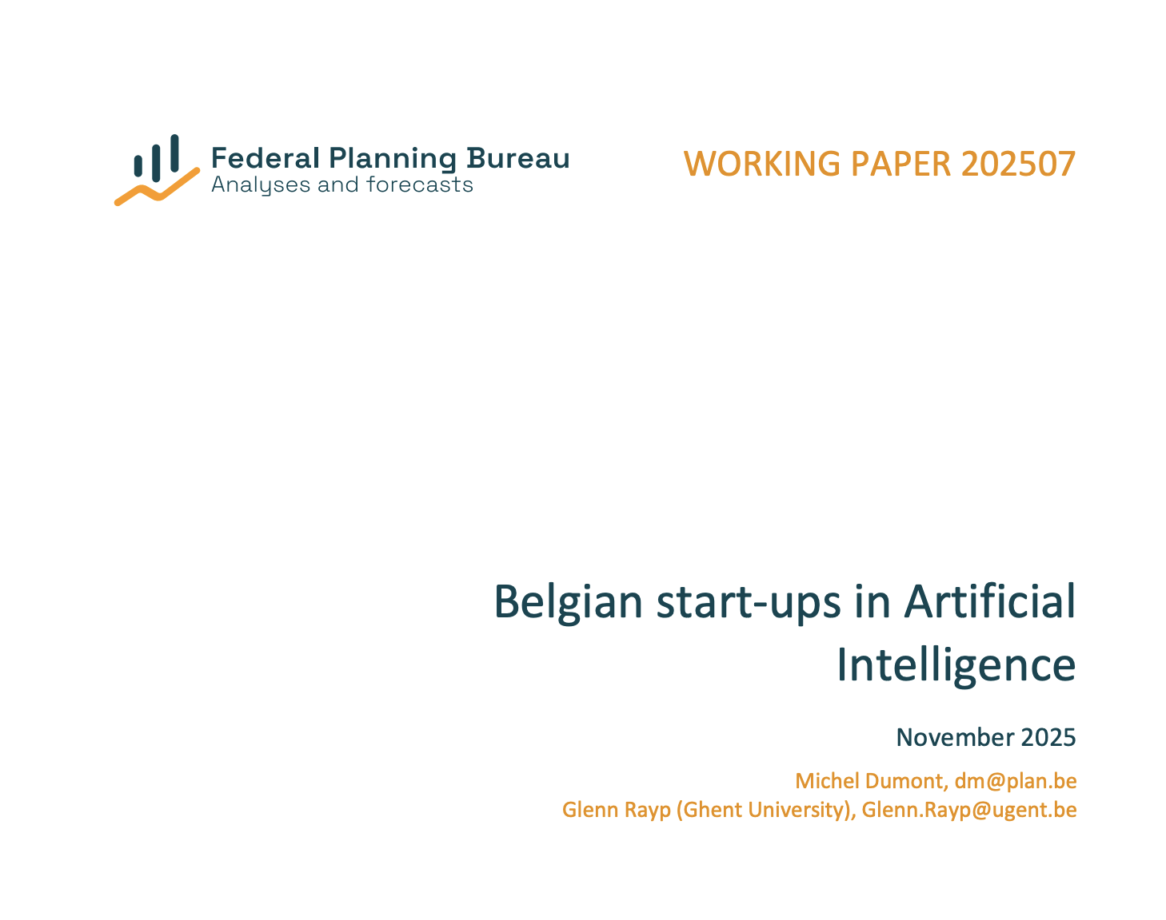

Slide 17
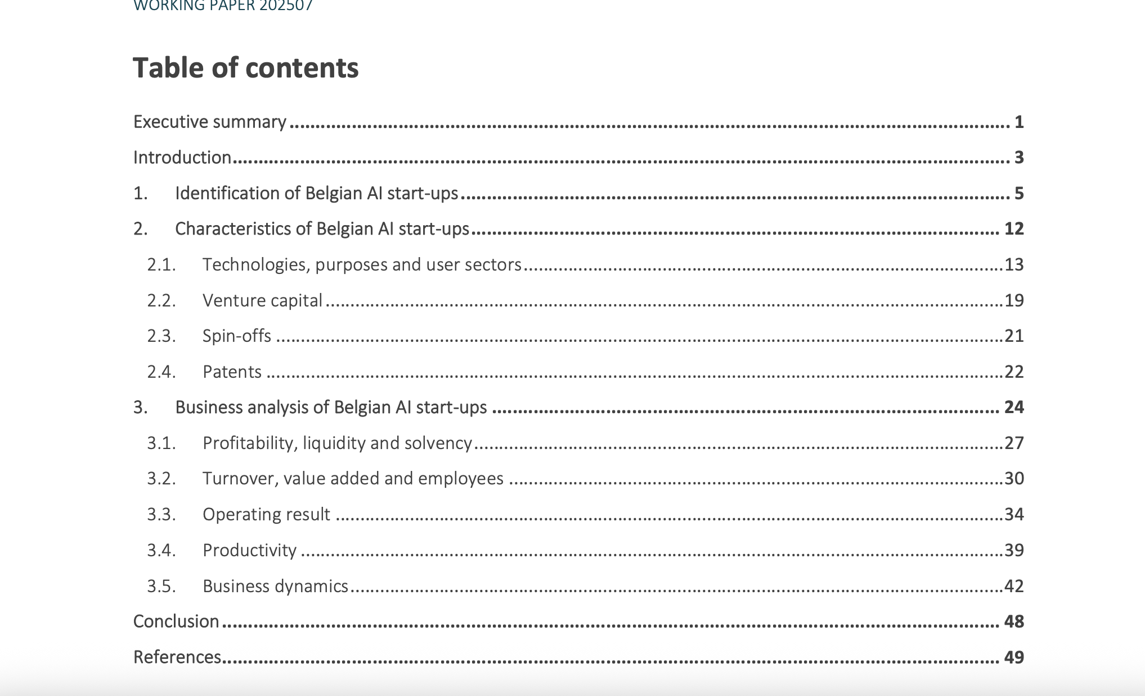

Slide 18
Find the standard questions for a scientific research article

Slide 19
The standard questions of an Executive Summary: the overall questions of a paper
What is the topic and the relevance?
What is the gap of knowledge?
What is the aim / research question?
How did we find the answers (our methods)?
What are our key results?
What are the main implications?

Slide 20
Executive Summary of this working paper
Reader’s questions
While SCANNING the section, try to match the standard questions for each paragraph.

Slide 21
Executive Summary of Belgian Startups
Paragraph | Question
1 | What is the topic? What is the relevance?
2 | What is the gap of knowledge? What is the aim of our research?
3 | (Methods) Why is the standard method for analysis not suitable for our study?
4 | Methods) So, how did we construct our overview of AI companies? And how many AI start-ups did we find?
5 | OUR RESULTS: Where are Belgian start-ups located?
6 | What AI technologies do they use? /For what tasks can the AI they offered be used? In which areas are they active?
7 | How do they perform financially?
8 | How do AI start-ups grow and profit?
9 | How do AI start-ups relate to venture capital?

Slide 22
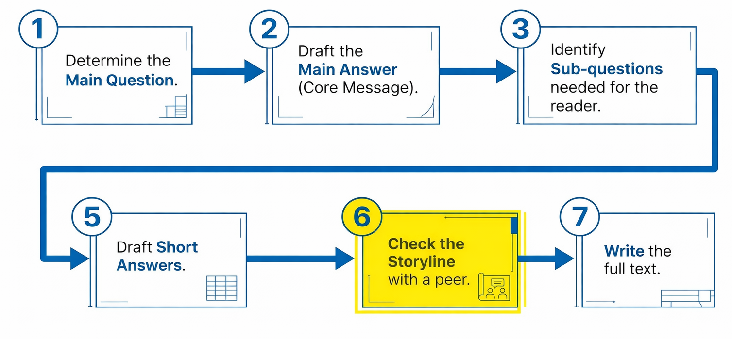
The 7-step plan

Slide 23
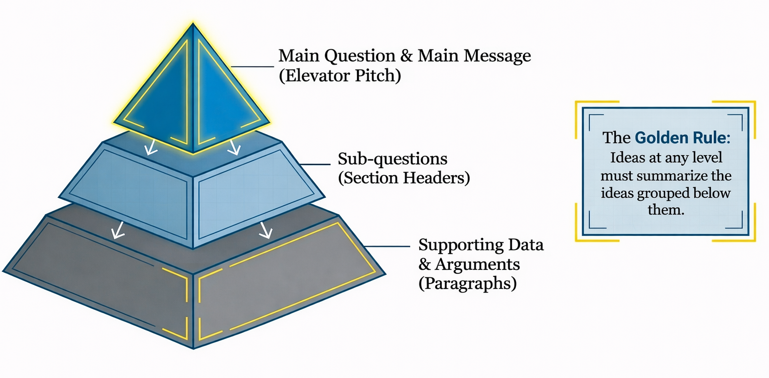
The Pyramid Principle

Slide 24
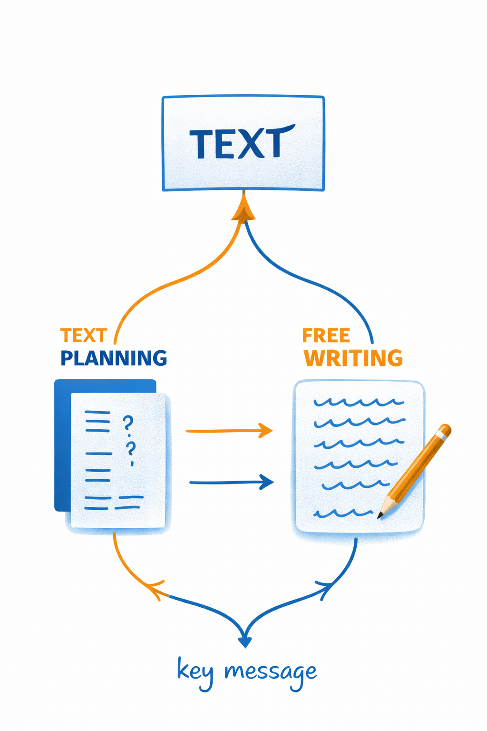

Slide 25
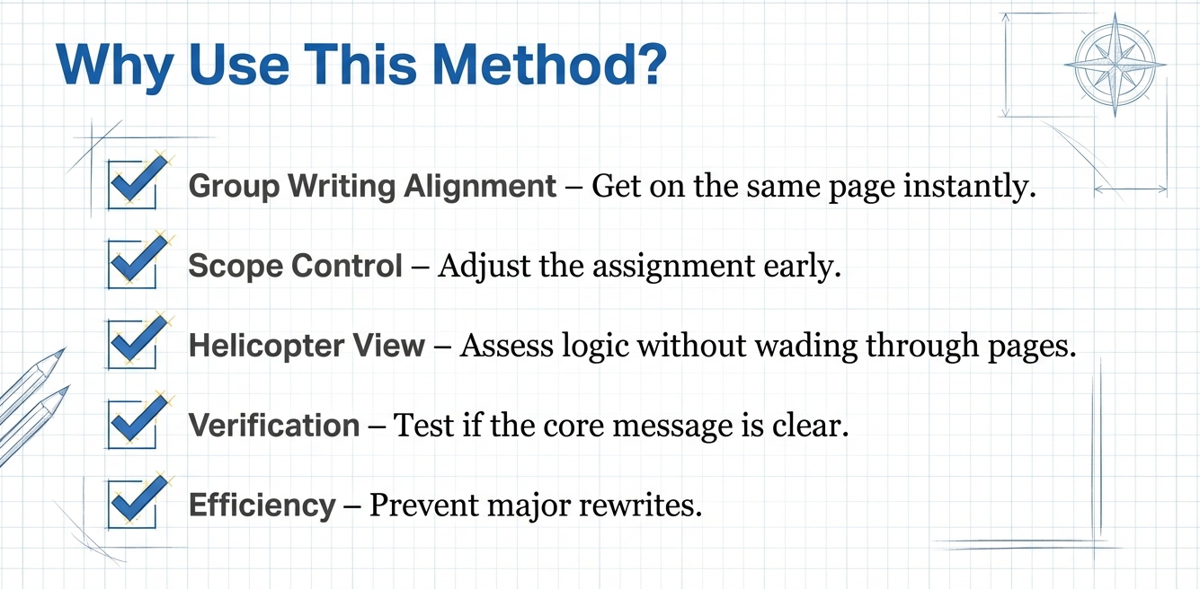

Slide 26
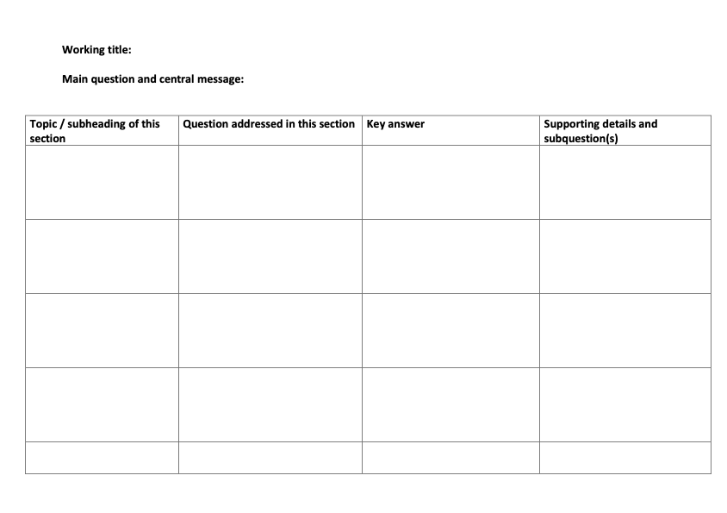

Slide 27
Go back to your stepwise writing process
Which step is currently missing or only implicit?
Which step would benefit from being made more explicit or split into two?
Which step could be moved forward to prevent later discussion or revision?

Slide 28
Text plan cases
Productivity effects of remote and hybrid work
Peer feedback in the writing process
Language complexity in policy communication
.........?

Slide 29
Mixed pairs: A and B
What information did the other mode produce that yours didn’t?
What gets clearer when you write like this?
What becomes harder?

Slide 30

The text plan for analysis

