Slide 1
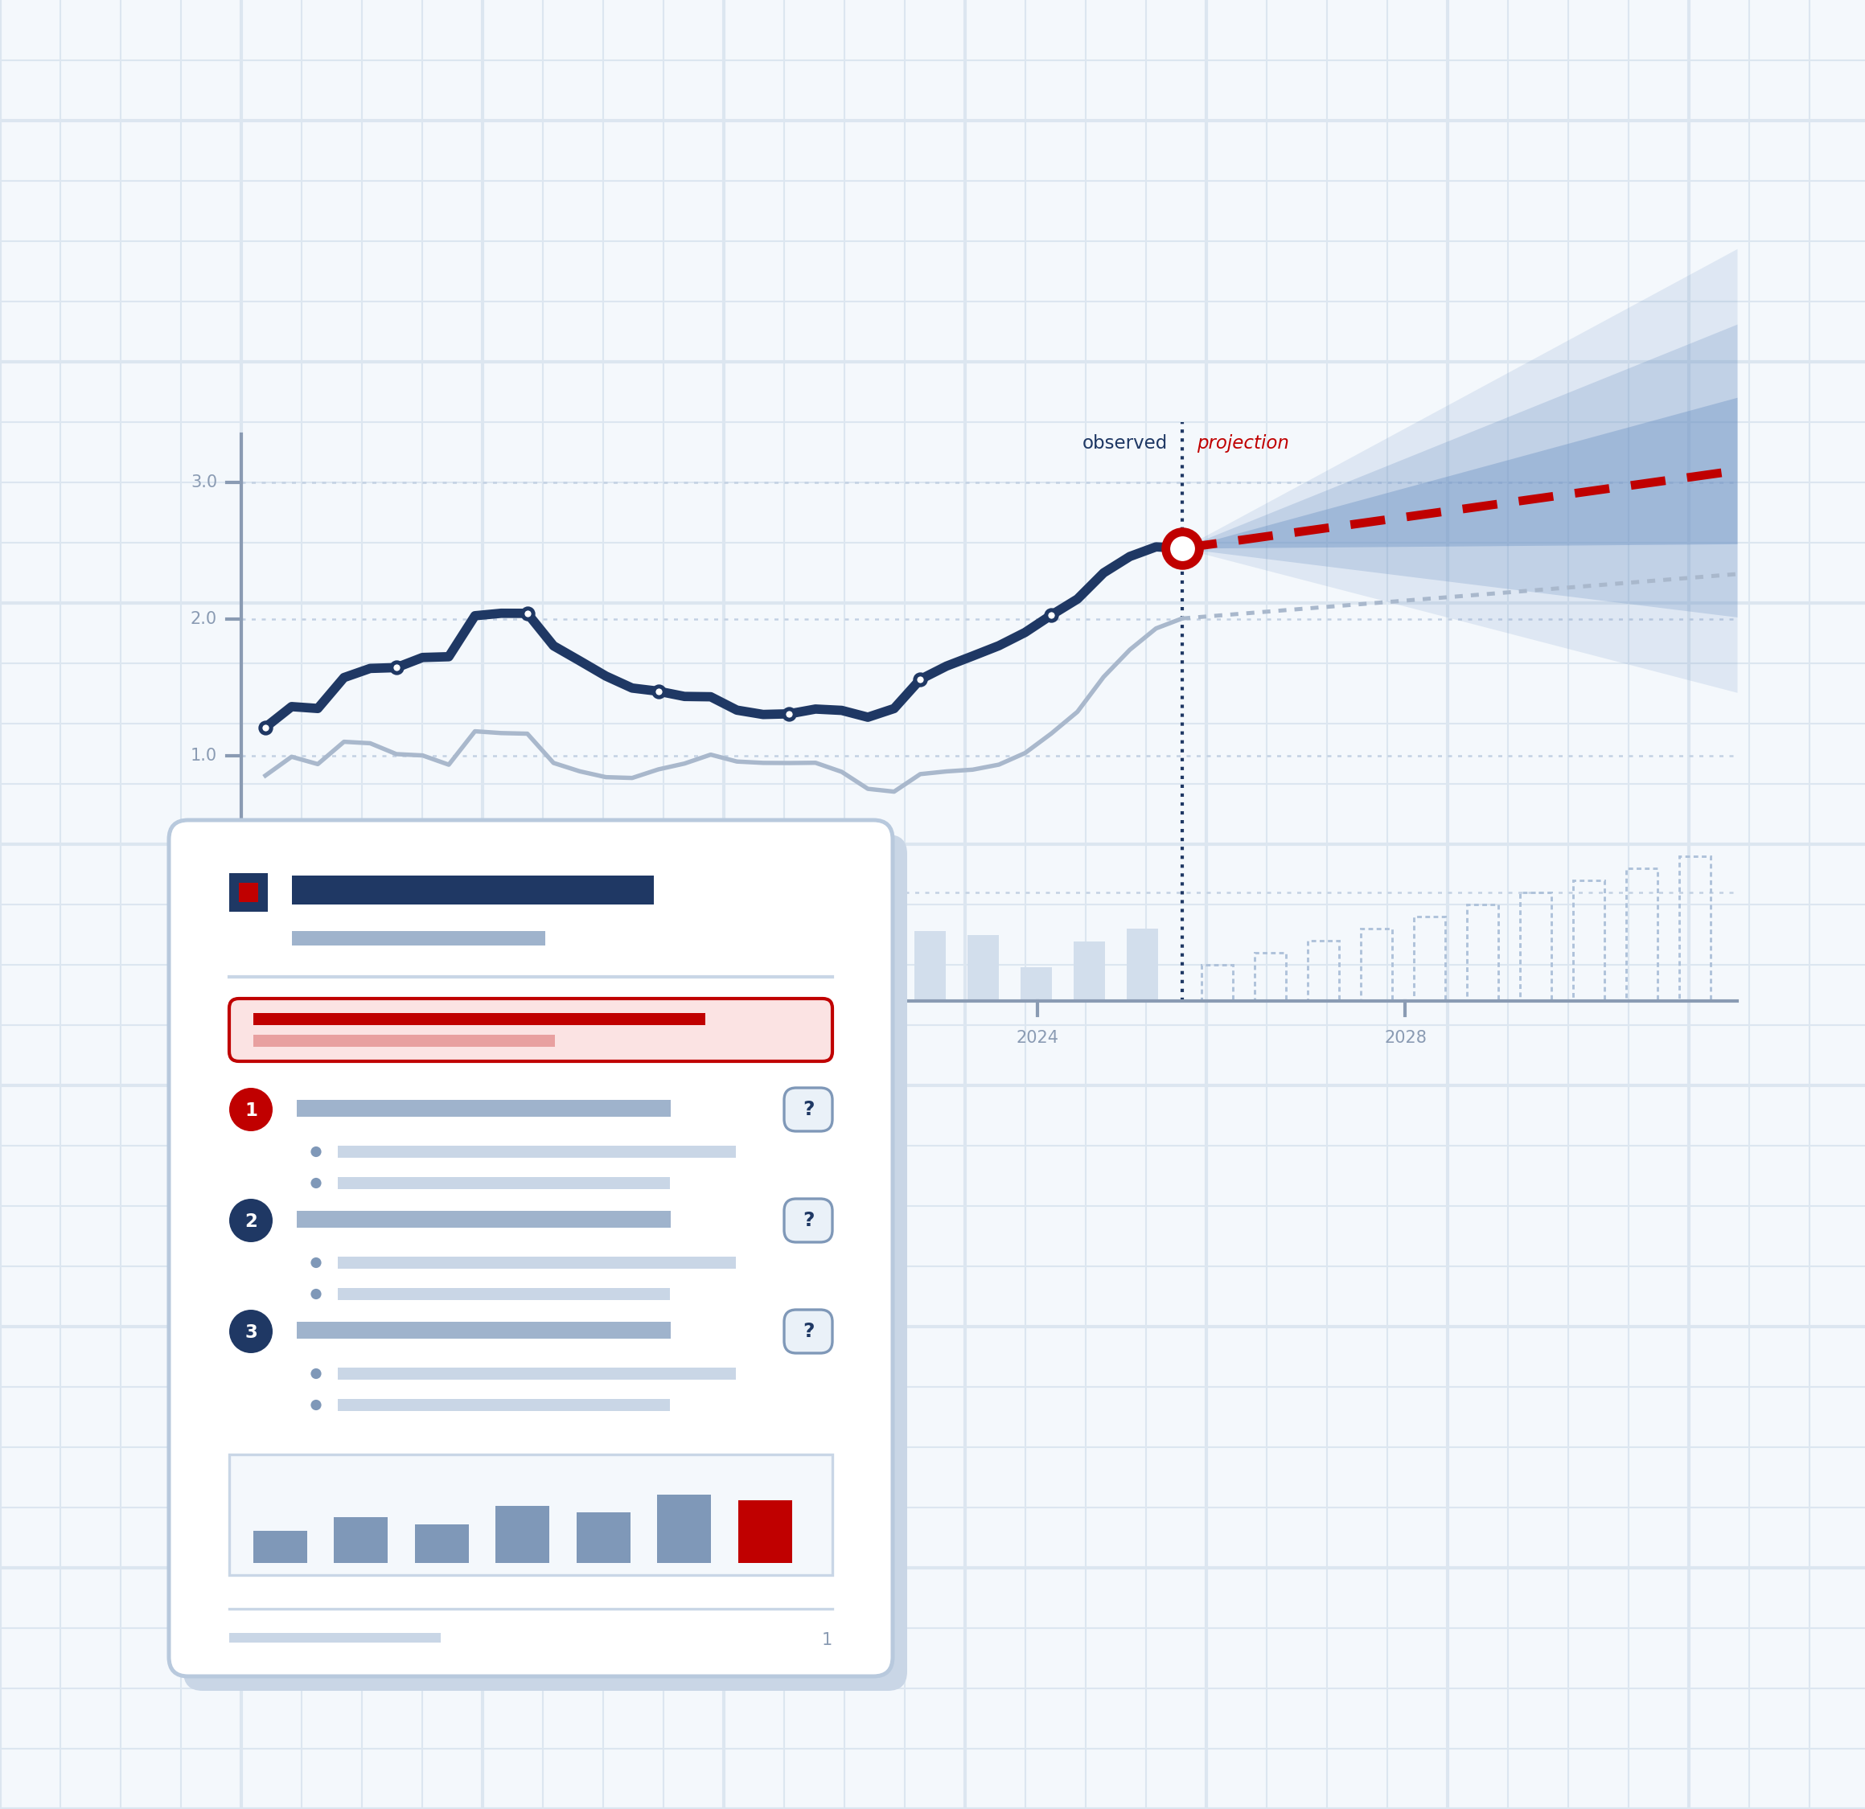
Text Planning
WORKSHOP
for the Federal Planning Bureau (FPB)
wetenschappelijkschrijven.nl

Slide 2
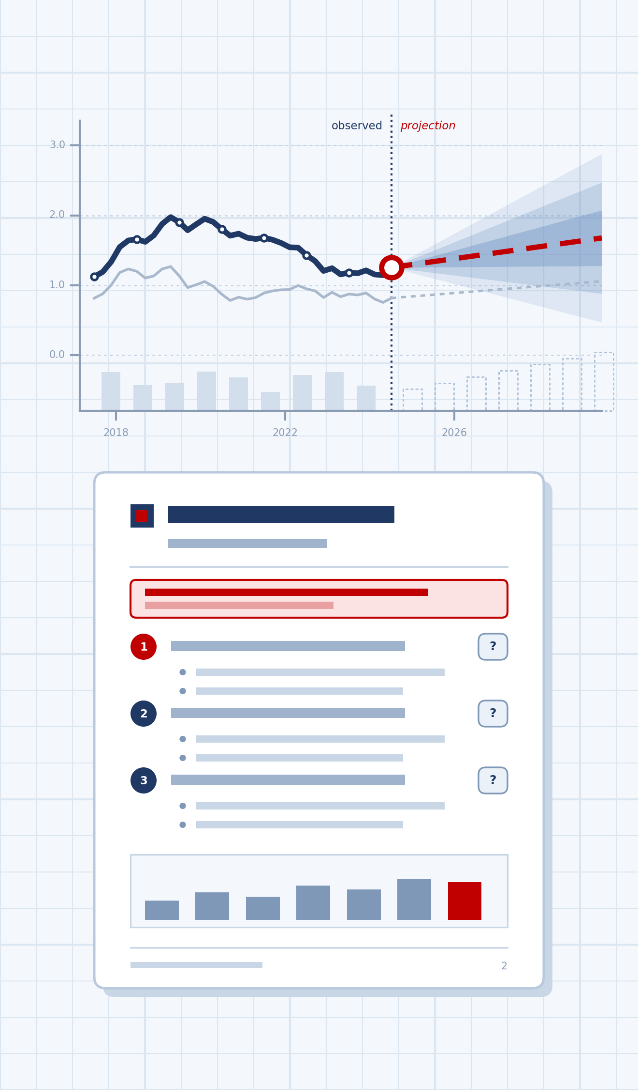
Academic writing, training and coaching
www.wetenschappelijkschrijven.nl
wetenschappelijkschrijven.nl 2

Slide 3
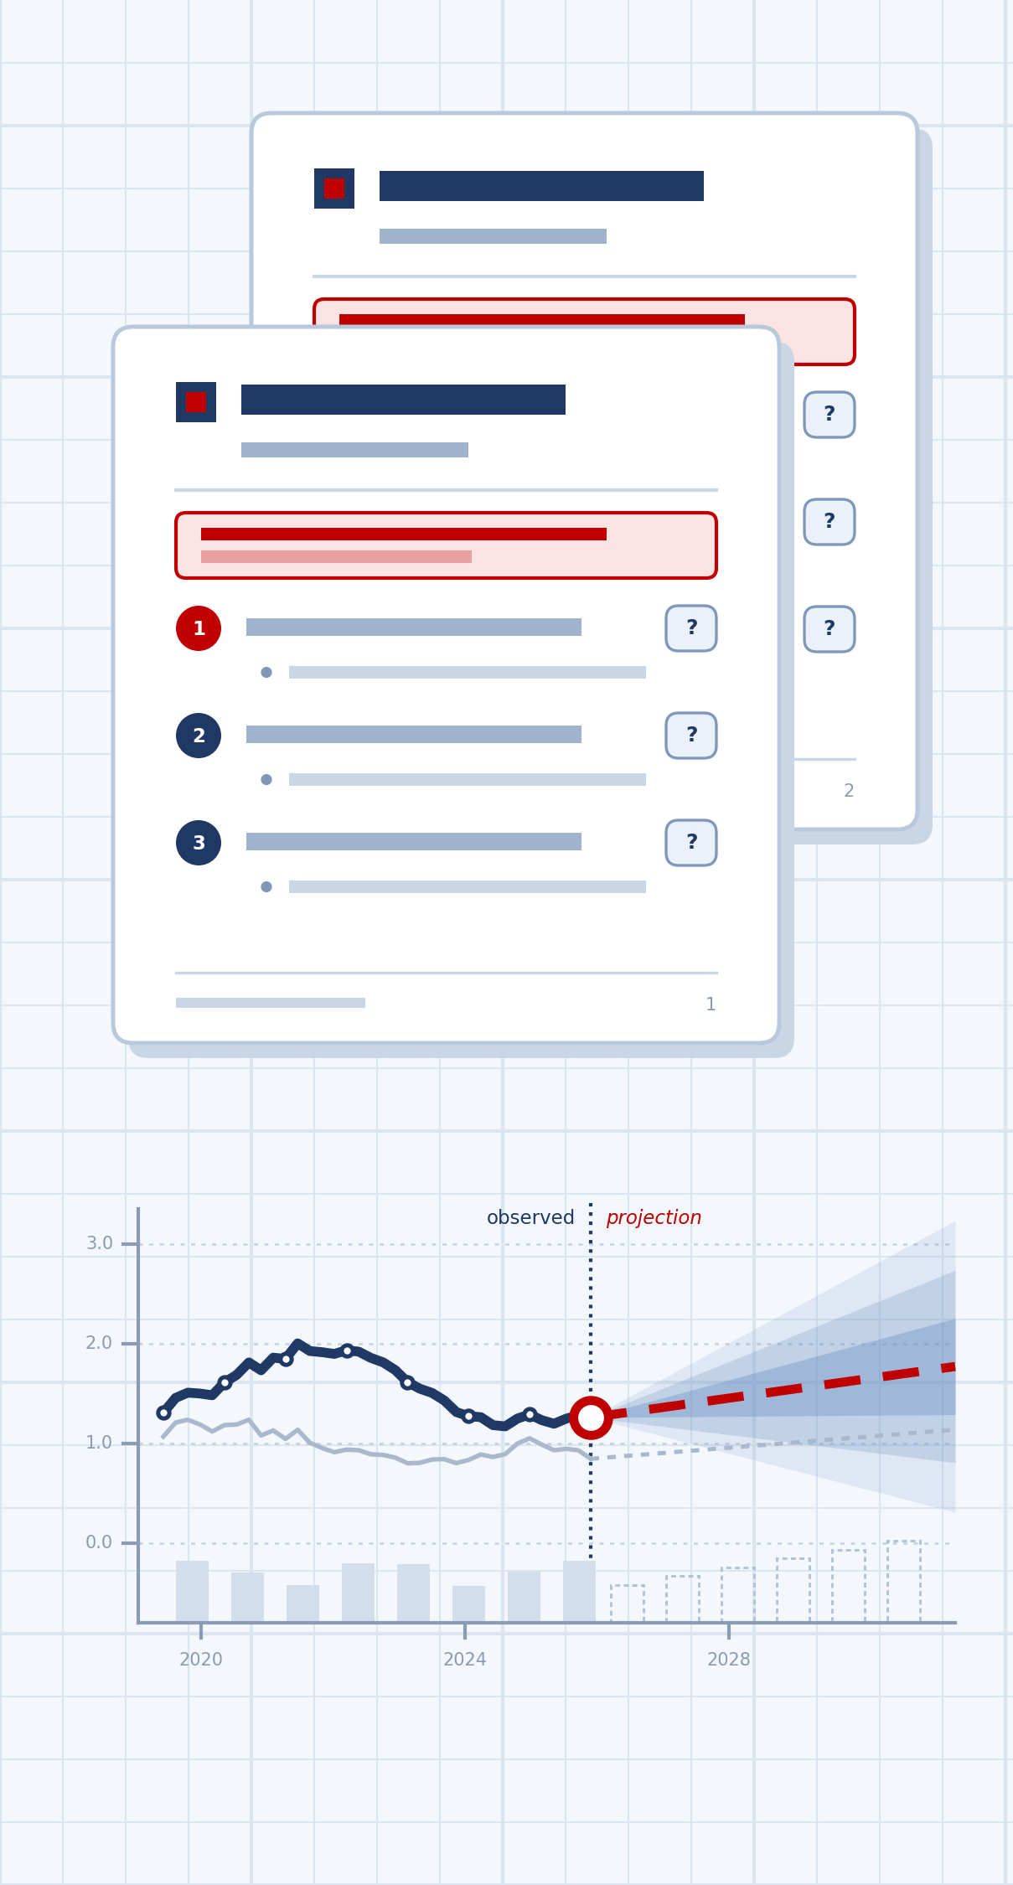
Agenda
OPENING
1
Opening
2
Your writing process
3
Part 1 From text to text plan
–
Break 11.00
5
Part 2 From text plan to text
wetenschappelijkschrijven.nl 4

Slide 4

What kind of writer are you?
OPENING QUIZ
Five dilemmas. No right answers. Scan the code with your phone.
Scan to start · ± 4 minutes

Slide 5
Are you an Architect, an Explorer or a Pragmatist?
OPENING · YOUR WRITER PROFILE
Hands up: which type did you get? And which type would you like to work with?
The Architect
Builds the frame before the walls.
STRENGTH
Co-authors and readers can follow you; big rewrites are rare.
RISK
The plan becomes a cage, and you stop discovering.
The Explorer
Finds out what they think by writing.
STRENGTH
Original thinking and real insight.
RISK
The reader gets your search instead of your answer.
The Pragmatist
Knows what works and delivers.
STRENGTH
Speed and reliability: papers get finished.
RISK
Every paper looks like the last one, whatever this reader needs.
wetenschappelijkschrijven.nl 6

Slide 6
Writing steps
OPENING
Choose from these steps or formulate your own – steps may be repeated
Write text
Make an outline or bullet list
Find key questions readers might have
Align structure with co-authors
Edit for style and grammar
Rewrite
Ask for feedback on …
List key messages per section
Discuss connections between sections
Just write freely to explore ideas (rough notes)
Your own step
Your own step
wetenschappelijkschrijven.nl 7
Notes:
After the activity: “Please don’t fix or optimize this yet. Just put it aside. We’ll come back to it at the end and see it with different eyes.”

Slide 7
From text to text plan
1
PART 1
Reading like a reader: which questions does a text answer?

Slide 8

The reader’s perspective
PART 1 · FROM TEXT TO TEXT PLAN
wetenschappelijkschrijven.nl 9

Slide 9
Text = answers to questions
PART 1 · FROM TEXT TO TEXT PLAN
Text
=
Answers to
the reader’s questions
+
Answers
you want your readers to remember
The reader asks – and the writer decides what matters most.
wetenschappelijkschrijven.nl 10

Slide 10
Why do so few households switch energy supplier?
Evidence from billing data and a letter experiment
What are your questions as a reader?
wetenschappelijkschrijven.nl 11
Notes:
Warm-up before the exercise, as with the inequality example. Show only the title and let participants list their questions as readers (2–3 minutes, individually or in pairs). Collect a few on a flip chart, then show the next slide.

Slide 11
What does the reader want to know?
PART 1 · FROM TEXT TO TEXT PLAN
Title: “Why do so few households switch energy supplier?”
How few is “few”?
Why does it matter?
Why don’t they switch?
How do we know?
What can be done?
wetenschappelijkschrijven.nl 12
Notes:
Show the five overall reader’s questions first. Ask participants which of their own questions fit under each heading. Then move on to the next slide, which adds the sub-questions and shows where the text answers them.

Slide 12
What does the reader want to know?
PART 1 · FROM TEXT TO TEXT PLAN
Title: “Why do so few households switch energy supplier?”
How few is “few”?
Why does it matter?
Why don’t they switch?
? What percentage switches?
? Few compared to what?
? Which households, which country, which period?
? Is not switching a problem?
? What does staying cost households?
? Who loses: households, competition?
? Lack of information, hassle, distrust or habit?
? Which reason matters most?
? Does it differ between groups?
→ Partly answered in ¶5
→ Answered in ¶1
→ Answered in ¶2 and ¶5
Not answered in the text
Few compared to what? Which country? Can staying be a rational choice?
Must a text answer every reader’s question?
How do we know?
What can be done?
? Survey, billing data or experiment?
? What people say – or what they do?
? Would better information help?
? Who should act: government, regulator, suppliers?
→ Answered in ¶3 and ¶4
→ Answered in ¶5 and ¶6
wetenschappelijkschrijven.nl 13
Notes:
Compare with the questions participants collected. Most reader questions are answered in the model text; some are not – which leads to a useful discussion: the writer chooses which reader questions to answer, and that choice is part of the text plan.
Optional: compare this title with one that gives the answer away, e.g. “Households don’t switch energy supplier – and information won’t change that”. Which questions does each title raise?

Slide 13
Find the skeleton
PART 1 · EXERCISE
Model text: “Why do so few households switch energy supplier?”
1
2
Read the article
Note the questions
Identify the questions that each part of the text answers.
Write them in the second column of the table.
wetenschappelijkschrijven.nl 14

Slide 14
Why do so few households switch energy supplier?
PART 1 · FROM TEXT TO TEXT PLAN
Evidence from billing data and a letter experiment · ¶1–3
1
Since the energy market was liberalised, households have been free to choose their electricity and gas supplier. Price differences between suppliers are substantial. Yet most households never switch and stay on their supplier’s standard contract, which is usually among the most expensive on offer. This matters for two reasons. Households pay more than necessary, and suppliers face less pressure to compete on price.
2
Previous research offers three explanations for this low switching rate. First, households may not know that cheaper contracts exist or how much they could save. Second, comparing contracts takes time and effort. Third, people tend to stick with what they have, even when a better option is available. So far, policy has focused mainly on the first explanation: comparison websites and information campaigns aim to make prices more transparent.
3
It is still unclear, however, which of these barriers matters most. Most studies rely on surveys that ask people whether they intend to switch, not whether they actually do. Yet intentions are a poor predictor of behaviour. As a result, we do not know whether more information will actually lead more households to switch. This paper therefore examines what stops households from switching supplier, and whether personalised information about potential savings changes their behaviour.
The study and all figures in this text are fictional.
wetenschappelijkschrijven.nl 15
Notes:
Paragraphs 1–3 of the model text. Leave this on screen while participants work, or use it in the plenary discussion.

Slide 15
Why do so few households switch energy supplier?
PART 1 · FROM TEXT TO TEXT PLAN
Evidence from billing data and a letter experiment · ¶4–6
4
To answer these questions, we combined three sources of data. We used three years of billing data from 4,000 households, which show who switched and how much they paid. We linked these data to a survey on households’ knowledge of the market and their reasons for staying. Finally, we ran an experiment: half of the households received a letter stating exactly how much they would save by switching.
5
Our results point to a clear pattern: households overpay, know it, and still stay put. Only 14% of households switched at least once in three years. Those that never switched paid on average €240 a year more than on the cheapest comparable contract. Yet lack of information was not the main barrier. Almost two-thirds of non-switchers knew that they could save money by changing supplier. Asked why they stayed, they mostly mentioned the expected hassle of switching and distrust of unfamiliar suppliers. In line with this, the personalised letter had only a modest effect. Within six months, 8% of households that received the letter switched, compared with 5% of those that did not. Moreover, the effect was concentrated among younger and more highly educated households. Older and low-income households, who often overpay the most, hardly responded.
6
These findings suggest that the main barrier to switching is effort and trust, not knowledge. Information helps households that are already inclined to act, but does little for those who find switching difficult or risky. For policy, this means that information campaigns alone are unlikely to raise switching substantially. Measures that reduce effort may be more effective, such as automatic switching services or a regulated, fairly priced default contract. Vulnerable households may also need personal assistance with switching.
The study and all figures in this text are fictional.
wetenschappelijkschrijven.nl 16
Notes:
Paragraphs 4–6. Point out the signal words in ¶5: “Our results point to a clear pattern…”, “Only 14%…”, “Yet…”, “In line with this…”.

Slide 16
The skeleton: text = answers to questions
PART 1 · FROM TEXT TO TEXT PLAN
Reader’s question
Answer (key message)
1
What is the topic, and why does it matter?
Most households stay on an expensive default contract; this costs them money and weakens competition.
2
What is already known?
Three explanations: lack of information, effort, and inertia. Policy mainly targets information.
What is the knowledge gap? And what are the research questions?
Unclear which barrier matters most (studies measure intentions). RQ 1: what stops households? RQ 2: does personalised information help?
3
4
How did we find the answers?
Billing data + survey + a randomised letter experiment among 4,000 households.
What are the key results?
How many switch, and at what cost? · What is the main barrier? (RQ 1) · Does information help, and for whom? (RQ 2)
Households overpay, know it, and still stay put: 14% switch, €240/yr overpaid; hassle and distrust, not information; letter: 8% vs 5%, mostly the better-off.
5
How can we interpret the findings? And what are the implications?
The barrier is effort and trust, not knowledge – so reduce effort: automatic switching, fair default contracts, personal help.
6
wetenschappelijkschrijven.nl 17
Notes:
Reveal after the pair discussion. Each paragraph answers one main reader’s question; ¶5 bundles three sub-questions under one overarching opening sentence.
Maps onto the standard questions: topic & relevance (¶1), known (¶2), gap + research questions (¶3), method (¶4), results (¶5), interpretation + implications (¶6). Limitations are deliberately left out.
Discussion (structure, not content): ¶3 and ¶6 each answer two questions – do they still feel like one paragraph? Should ¶5 be split in a longer paper? Would a reader of a working paper miss the limitations, and where would they go?

Slide 17
Four paragraph shapes
PART 1 · FROM TEXT TO TEXT PLAN
Where does the paragraph put its key message?
Frame
1
2
3
The pyramid
The funnel
The diamond
The bookcase
Key message first
Key message last
Key message first – new one last
A frame with items
The first sentence states the key message; the rest explains, supports or illustrates it.
Starts broad and narrows down to the key message at the end. Scanning readers may miss the point.
Opens with a key message, develops it, and ends with a new one. “Therefore” or “so” marks the turn.
A frame sentence announces a set of items; they follow side by side: First, Second, Finally …
Use for: Results, discussion, policy texts
Use for: Openings, building an argument
Use for: Turning points: gap → aim, findings → implications
Use for: Overviews, methods, causes/effects
wetenschappelijkschrijven.nl 18
Notes:
In each diagram, red marks the key message. The diamond has two: it opens with a key message and ends with a new one that builds on it (e.g. gap → aim). Real paragraphs often mix shapes; what matters is that the reader knows where to find the key message.

Slide 18
Paragraph 1: the funnel
PART 1 · PARAGRAPH SHAPES IN THE MODEL TEXT
THE TEXT
¶1
The funnel
Since the energy market was liberalised, households have been free to choose their electricity and gas supplier. Price differences between suppliers are substantial. Yet most households never switch and stay on their supplier’s standard contract, which is usually among the most expensive on offer. This matters for two reasons. Households pay more than necessary, and suppliers face less pressure to compete on price.
Context: households can choose their supplier
Price differences are substantial
Yet most never switch and stay on an expensive contract
Why this shape? The paragraph starts broad (the open market) and narrows down step by step to the problem and why it matters. The key message comes last – a good shape for an opening, but scanning readers may miss the point.
This matters: households overpay, competition weakens
The study and all figures in this text are fictional.
wetenschappelijkschrijven.nl 19
Notes:
Red = key message(s); in the text on the right the key sentence is printed in bold red.
¶1 is a funnel. Ask participants to rewrite it as a pyramid: what do you gain, and what do you lose?

Slide 19
Paragraph 2: the bookcase
PART 1 · PARAGRAPH SHAPES IN THE MODEL TEXT
THE TEXT
¶2
The bookcase
Previous research offers three explanations for this low switching rate. First, households may not know that cheaper contracts exist or how much they could save. Second, comparing contracts takes time and effort. Third, people tend to stick with what they have, even when a better option is available. So far, policy has focused mainly on the first explanation: comparison websites and information campaigns aim to make prices more transparent.
“Previous research offers three explanations …”
First: households lack information about cheaper contracts
Second: comparing contracts takes time and effort
Third: people stick with what they have
Why this shape? The frame sentence announces a list (“three explanations”); First, Second and Third mark the items. The last sentence rounds off the list and prepares the gap in ¶3.
Closing: policy has focused mainly on the first
The study and all figures in this text are fictional.
wetenschappelijkschrijven.nl 20
Notes:
Red = key message(s); in the text on the right the key sentence is printed in bold red.
¶2 is a bookcase: frame sentence + three items. Ask which words show the reader that a list is coming.

Slide 20
Paragraph 3: the diamond
PART 1 · PARAGRAPH SHAPES IN THE MODEL TEXT
THE TEXT
¶3
The diamond
It is still unclear, however, which of these barriers matters most. Most studies rely on surveys that ask people whether they intend to switch, not whether they actually do. Yet intentions are a poor predictor of behaviour. As a result, we do not know whether more information will actually lead more households to switch. This paper therefore examines what stops households from switching supplier, and whether personalised information about potential savings changes their behaviour.
It is still unclear which barrier matters most
Studies measure intentions, not behaviour
Intentions predict behaviour poorly
New: the aim – what stops households, and does information help?
Why this shape? The paragraph opens with a key message (the gap) and ends with a new one (the aim). The middle sentences explain why the gap exists; “therefore” marks the turn.
The study and all figures in this text are fictional.
wetenschappelijkschrijven.nl 21
Notes:
Red = key message(s); in the text on the right the key sentence is printed in bold red.
¶3 is a diamond: it opens with the gap and ends with a new key message, the aim of the paper. “Therefore” marks the turn.

Slide 21
Paragraph 4: the bookcase
PART 1 · PARAGRAPH SHAPES IN THE MODEL TEXT
THE TEXT
¶4
The bookcase
To answer these questions, we combined three sources of data. We used three years of billing data from 4,000 households, which show who switched and how much they paid. We linked these data to a survey on households’ knowledge of the market and their reasons for staying. Finally, we ran an experiment: half of the households received a letter stating exactly how much they would save by switching.
“We combined three sources of data …”
Billing data: 4,000 households, three years
Survey: market knowledge and reasons for staying
Experiment: a letter showing personal savings
Why this shape? The frame sentence announces three data sources; “We used”, “We linked” and “Finally” mark the items. Typical for a method paragraph.
The study and all figures in this text are fictional.
wetenschappelijkschrijven.nl 22
Notes:
Red = key message(s); in the text on the right the key sentence is printed in bold red.
¶4 is a bookcase – typical for method paragraphs. Readers want an overview of the components.

Slide 22
Paragraph 5: a pyramid with a bookcase inside
PART 1 · PARAGRAPH SHAPES IN THE MODEL TEXT
THE TEXT
¶5
A pyramid with a bookcase inside
Our results point to a clear pattern: households overpay, know it, and still stay put. Only 14% of households switched at least once in three years. Those that never switched paid on average €240 a year more than on the cheapest comparable contract. Yet lack of information was not the main barrier. Almost two-thirds of non-switchers knew that they could save money by changing supplier. Asked why they stayed, they mostly mentioned the expected hassle of switching and distrust of unfamiliar suppliers. In line with this, the personalised letter had only a modest effect. Within six months, 8% of households that received the letter switched, compared with 5% of those that did not. Moreover, the effect was concentrated among younger and more highly educated households. Older and low-income households, who often overpay the most, hardly responded.
Overarching opening sentence
Households overpay, know it, and still stay put
“Only 14% …”
few switch; non-switchers overpay €240 a year
“Yet …”
not information but hassle and distrust
“In line with this …”
the letter had a modest effect (8% vs 5%)
Why this shape? The overarching first sentence summarises all findings. Three findings follow side by side, each with a signal word: “Only 14%”, “Yet”, “In line with this”. The Golden Rule at paragraph level.
The study and all figures in this text are fictional.
wetenschappelijkschrijven.nl 23
Notes:
Red = key message(s); in the text on the right the key sentence is printed in bold red.
¶5 combines a pyramid and a bookcase: the Pyramid Principle at paragraph level. Should it be split into three paragraphs in a longer paper?

Slide 23
Paragraph 6: the pyramid
PART 1 · PARAGRAPH SHAPES IN THE MODEL TEXT
THE TEXT
¶6
The pyramid
These findings suggest that the main barrier to switching is effort and trust, not knowledge. Information helps households that are already inclined to act, but does little for those who find switching difficult or risky. For policy, this means that information campaigns alone are unlikely to raise switching substantially. Measures that reduce effort may be more effective, such as automatic switching services or a regulated, fairly priced default contract. Vulnerable households may also need personal assistance with switching.
The barrier is effort and trust, not knowledge
Information helps only those inclined to act
For policy: information alone won’t do
Reduce effort: auto-switching, fair default, personal help
Why this shape? The key message comes first; the paragraph then works down from interpretation to concrete measures. “For policy, this means” marks the step to implications.
The study and all figures in this text are fictional.
wetenschappelijkschrijven.nl 24
Notes:
Red = key message(s); in the text on the right the key sentence is printed in bold red.
Discussion: is ¶6 a pyramid or a diamond? Does it end with a new key message (the policy implication), or only with support for the first?

Slide 24
Recognise the shape
PART 1 · FROM TEXT TO TEXT PLAN
Shape
Key message sits …
1
Funnel
at the end
Your own text
Pick one section of your own paper.
Which shape does each paragraph have?
Where is the key message – and is that where your reader expects it?
Which paragraph would work better as a pyramid?
2
Bookcase
in the frame sentence
3
Diamond
at the start + new one at the end
4
Bookcase
in the frame sentence
5
Pyramid + bookcase
at the start
6
Pyramid
at the start
wetenschappelijkschrijven.nl 30
Notes:
Transfer to their own writing. Mixed shapes are fine; the point is that the reader can find the key message. Most research paragraphs benefit from the pyramid: readers scan first sentences.

Slide 25
Which questions does each section answer?
PART 1 · EXERCISE
Section | Questions
Executive Summary
1. Introduction
2. Method
3. Results
4. Conclusion / Discussion
wetenschappelijkschrijven.nl 31

Slide 26
The standard questions per section
PART 1 · FROM TEXT TO TEXT PLAN
Section | Questions
Executive Summary | Overall questions: gap, methods, findings, implications?
1. Introduction | What is the topic? What does the research add? Why is it relevant? What is known from the literature? What is the knowledge gap? What are the research questions?
2. Method | What data (and methods) do we use?
3. Results | What are the findings? (Answers to the research questions)
4. Conclusion / Discussion | What are the main findings and what do they mean? How can we interpret or explain them? Why are the findings surprising / not surprising? What are the limitations of this research? What can we conclude from the findings? How do we look to the future?
wetenschappelijkschrijven.nl 32

Slide 27
From text plan to text
2
PART 2
Plan the structure first – then write

Slide 28
The 6-step plan
PART 2 · FROM TEXT PLAN TO TEXT
From main question to full text – step by step
6
5
Write the Full Text
4
Check and discuss the Storyline with a peer
3
Draft Short Answers
2
Identify the Sub-questions needed for the reader
1
Draft the Main Answer (core message)
Determine the Main Question
PEER FEEDBACK
wetenschappelijkschrijven.nl 34
Notes:
Read the plan from bottom left to top right: each step builds on the one below. Step 5 – checking and discussing the storyline with a peer – is highlighted: this is where the text plan pays off, before the full text is written.

Slide 29
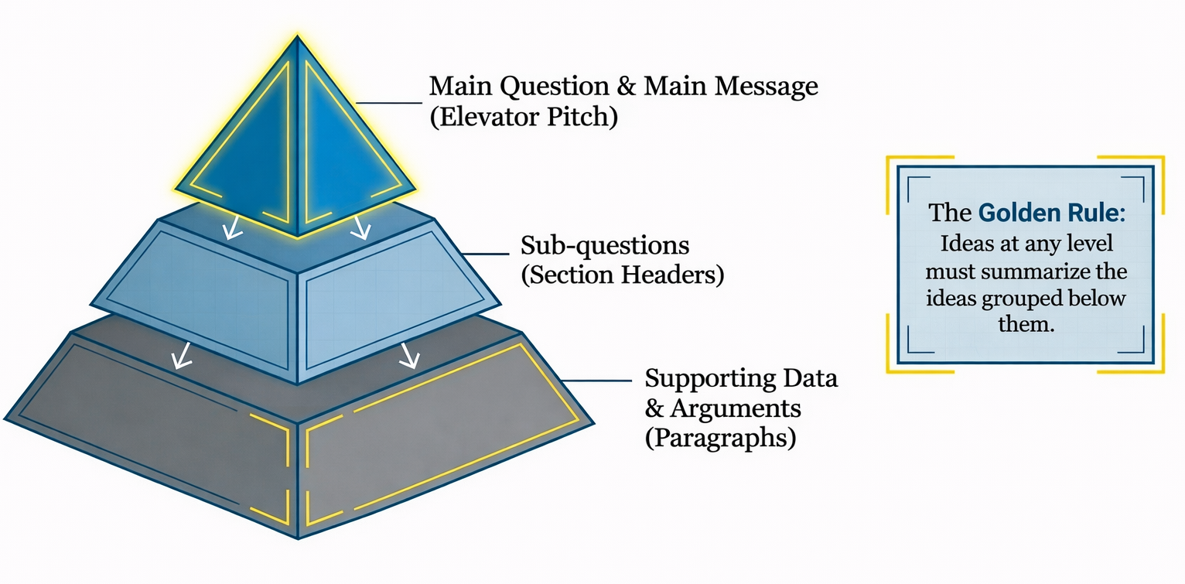
The Pyramid Principle
PART 2 · FROM TEXT PLAN TO TEXT
wetenschappelijkschrijven.nl 35

Slide 30
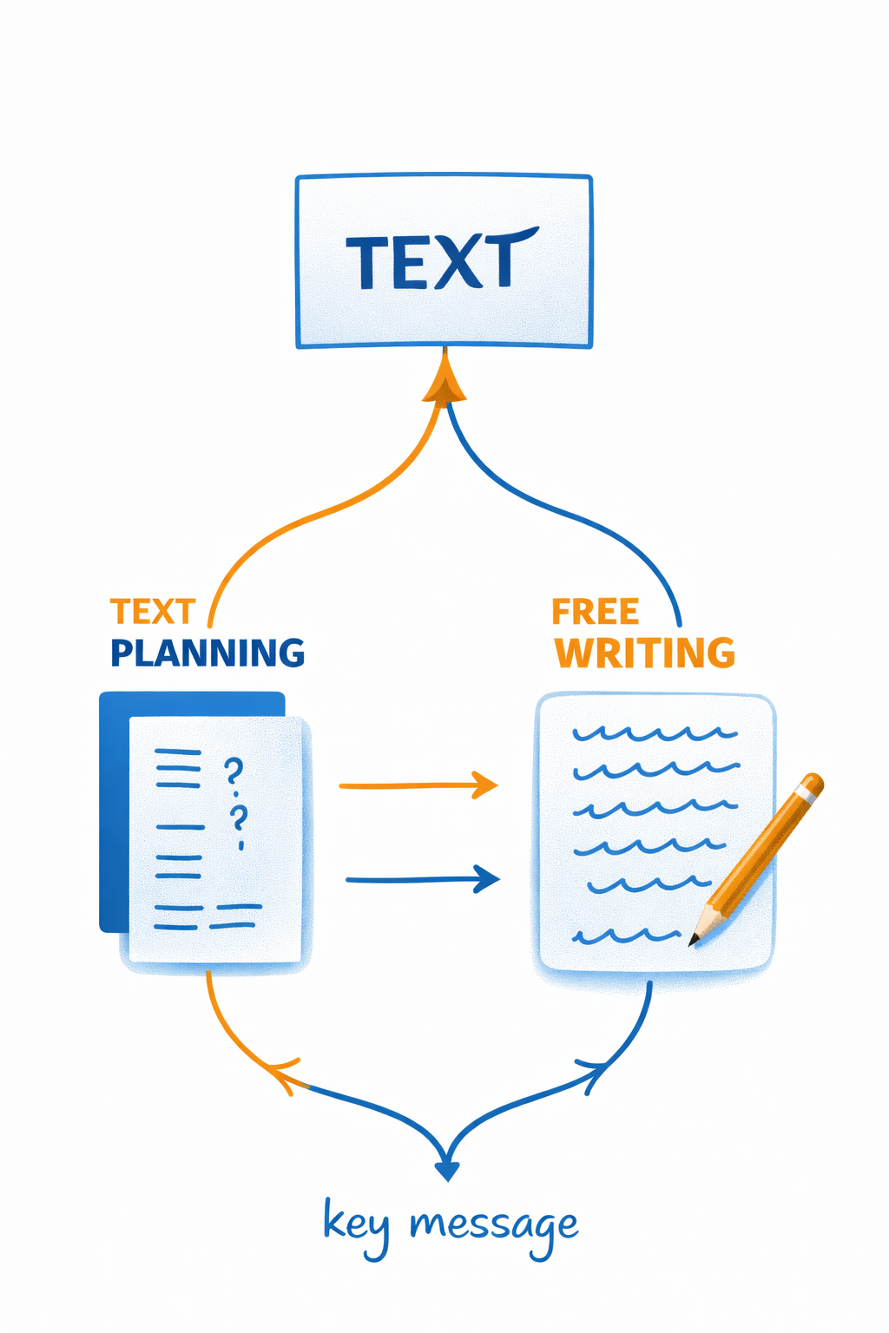
Text planning and free writing
PART 2 · FROM TEXT PLAN TO TEXT
Two routes to a text – both start from the key message.
Text planning works top-down from questions and answers; free writing explores ideas first. Both come together in the text.
wetenschappelijkschrijven.nl 36

Slide 31
Why use this method?
PART 2 · FROM TEXT PLAN TO TEXT
Group writing alignment – Get on the same page instantly.
✓
Scope control – Adjust the assignment early.
✓
Helicopter view – Assess logic without wading through pages.
✓
Verification – Test if the core message is clear.
✓
Efficiency – Prevent major rewrites.
✓
wetenschappelijkschrijven.nl 37

Slide 32
Text plan template
PART 2 · FROM TEXT PLAN TO TEXT
Working title:
Main question and central message:
Topic / subheading of this section | Question addressed in this section | Key answer | Supporting details and sub-question(s)
wetenschappelijkschrijven.nl 38

Slide 33
A text plan in reader’s questions
PART 2 · EXAMPLE: A TEXT PLAN IN READER’S QUESTIONS
Working title: “Free fares, full buses, same traffic? The effects of free public transport for young people”
MAIN QUESTION Does free public transport for young people reduce their car use?
CENTRAL MESSAGE Free fares sharply increased public transport use among 18–25-year-olds but barely reduced car use, because the new trips mainly replaced cycling and walking. As a car-reduction measure the scheme is expensive and ineffective; it should be judged as social policy.
GENERAL questions
The standard questions every paper of this type answers – one per section. They give the skeleton.
SPECIFIC questions
The concrete questions this reader has about this study – often one per paragraph. They give the argument.
wetenschappelijkschrijven.nl 39
Notes:
Fictional example. The following slides show the plan section by section: a blue band with the general question, and white rows with the specific questions and their key answers.

Slide 34
Text plan · 1. Introduction
PART 2 · EXAMPLE: A TEXT PLAN IN READER’S QUESTIONS
GENERAL
Free fares are popular as a climate and congestion measure, but we do not know whether they actually get young people out of their cars.
What is the topic, why does it matter, and what does this paper add?
SPECIFIC QUESTION
KEY ANSWER
Policy context
Why are governments interested in free public transport?
Several regions have abolished fares for young people, hoping to reduce car use, emissions and congestion.
Why young people?
Why focus on 18–25-year-olds?
Travel habits formed at this age tend to last; it is also when many people buy their first car.
Literature
What do we already know?
Free fares raise ridership; evidence on car use is mixed and comes mostly from cities with short trips.
Gap and aim
What is still missing – and what does this paper ask?
Few studies use a control group and data on all modes. RQs: effect on public transport and car use; origin of new trips; car ownership.
wetenschappelijkschrijven.nl 40
Notes:
Blue band = the general (standard) question of this section. White rows = specific reader’s questions, roughly one per paragraph.

Slide 35
Text plan · 2. Data and method
PART 2 · EXAMPLE: A TEXT PLAN IN READER’S QUESTIONS
GENERAL
We compare young people in a region with free fares to a similar region without, before and after the change.
How did we find the answers?
SPECIFIC QUESTION
KEY ANSWER
The policy change
What exactly changed, and when?
Region A abolished fares for 18–25-year-olds in January 2023; region B did not.
Data
Which data do we use?
Travel diaries of 3,200 young people (two years before and after), smart-card data and car registrations.
Method
How do we isolate the effect of free fares?
Difference-in-differences: the change in region A minus the change in region B.
Reliability
Can we trust this comparison?
Yes: trends were parallel before 2023, and results hold in robustness checks.
wetenschappelijkschrijven.nl 41
Notes:
Blue band = the general (standard) question of this section. White rows = specific reader’s questions, roughly one per paragraph.

Slide 36
Text plan · 3. Results
PART 2 · EXAMPLE: A TEXT PLAN IN READER’S QUESTIONS
GENERAL
Public transport use rose sharply, car use hardly fell, and car ownership did not change.
What did we find?
SPECIFIC QUESTION
KEY ANSWER
Public transport use
How much did public transport use change?
+35% among 18–25-year-olds in region A.
Car use
Did car use fall?
Only by 3%.
Origin of new trips
Where did the new trips come from?
Half replaced cycling and walking, a third were new trips, one in six replaced a car trip.
Car ownership
Did fewer young people buy a car?
No: 11% bought one in the treatment group, 12% in the control group.
Differences between groups
Are the effects different for some groups?
Ridership rose most among students and low-income youth; the effect on car use was small in all groups.
wetenschappelijkschrijven.nl 42
Notes:
Blue band = the general (standard) question of this section. White rows = specific reader’s questions, roughly one per paragraph.
Note how “Did car use fall?” is raised by the previous answer (+35% public transport).

Slide 37
Text plan · 4. Discussion and conclusion
PART 2 · EXAMPLE: A TEXT PLAN IN READER’S QUESTIONS
GENERAL
Free fares mainly attract people who used to cycle or walk; as a car-reduction measure the scheme is expensive and ineffective.
What do the findings mean?
SPECIFIC QUESTION
KEY ANSWER
Explanation
Why did car use hardly fall, although public transport use rose so sharply?
Free public transport competes mainly with cycling and walking, not with the car.
Objection
Isn’t two years simply too short to see an effect?
Probably not: no change between year 1 and year 2, no difference in car purchases.
Limitations
How far can we generalise these results?
One region, two years, self-reported diaries: effects may differ in large cities.
Policy implications
So is free public transport worth it?
Not as a climate or congestion measure; judge it as social policy, or combine it with measures on the car side.
wetenschappelijkschrijven.nl 43
Notes:
Blue band = the general (standard) question of this section. White rows = specific reader’s questions, roughly one per paragraph.
These four questions correspond to the four discussion paragraphs of the full text.

Slide 38
Why a text plan needs both kinds of questions
PART 2 · EXAMPLE: A TEXT PLAN IN READER’S QUESTIONS
General questions give the skeleton
They come from the genre and decide the sections and their order – readers know where to find the method or the conclusion.
Specific questions give the argument
They come from this topic and this reader and decide the paragraphs – what this text actually says.
SPECIFIC QUESTIONS OFTEN ARISE FROM THE PREVIOUS ANSWER
Public transport use +35%
→
Did car use fall?
→
Only –3%: why not?
→
Isn’t two years too short?
→
So is it worth it?
Tip for co-authors: agree on the general questions first (the sections), then on the specific questions (the paragraphs), and only then on the key answers. Most disagreements show up in the key-answer column – long before anyone has written a full paragraph.
wetenschappelijkschrijven.nl 44
Notes:
Only general questions = a template: it could belong to any paper. Only specific questions = a list without order.
Discussion: Which specific question would you add for a policy maker? And for a fellow economist? Section 4 has no row for “Why are the findings surprising?” – would you add it?

Slide 39
Go back to your stepwise writing process
REFLECTION
1
2
3
Which step is currently missing or only implicit?
Which step would benefit from being made more explicit or split into two?
Which step could be moved forward to prevent later discussion or revision?
Don’t ask: “Is this good or bad?” – look at your plan with different eyes.
wetenschappelijkschrijven.nl 45
Notes:
At the start of today, you mapped your own writing process – the steps you typically take once the data and main message are clear.
Since then, we’ve talked about structure, core messages, feedback rounds, and using the reader’s perspective early in the process.
Please take another look at your own plan. Don’t ask: “Is this good or bad?” Instead, ask yourself the three questions on the slide.

Slide 40
Hybrid and complex audiences
PART 2 · FROM TEXT PLAN TO TEXT
Talk to them – identify their questions
1
Think about their different goals – how can you serve them?
2
Address them in your introduction – show them the way
3
Make your text super transparent – helicopter-friendly
4
Edit for maximum clarity at sentence level – max. 20–24 words per sentence
5
wetenschappelijkschrijven.nl 46

Slide 41
Text plan cases
PART 2 · EXERCISE
1
2
Productivity effects of remote and hybrid work
Peer feedback in the writing process
3
?
Language complexity in policy communication
Your own case …
wetenschappelijkschrijven.nl 47

Slide 42
Mixed pairs: A and B
PART 2 · EXERCISE
?
?
?
What information did the other mode produce that yours didn’t?
What gets clearer when you write like this?
What becomes harder?
wetenschappelijkschrijven.nl 48

Slide 43

The text plan for analysis
PART 2

Slide 44
About text planning
PART 2 · FROM TEXT PLAN TO TEXT
1
2
Today is not about MAKING text plans, but WORKING with text plans.
A text plan is a working document, not a product.
3
4
A text plan will evolve on the way, and grow into a well-built text.
The aim is to support the writing process: a transparent structure + effective peer feedback.
wetenschappelijkschrijven.nl 50

